Slide 1
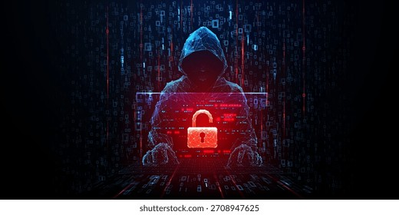
PHISHING AWARENESS
TRAINING
CodeAlpha Internship — Khadija

Slide 2
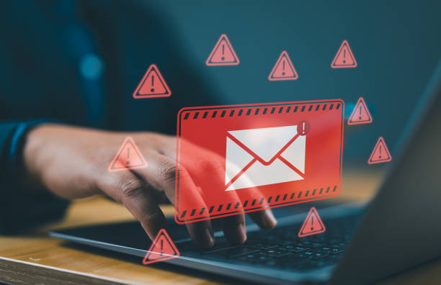
What is Phishing?
Phishing is a cyber attack where attackers impersonate trusted entities to steal sensitive information like passwords, credit card numbers, or personal data.
The term comes from "fishing" — attackers cast a wide net, hoping someone takes the bait.
3.4 Billion
phishing emails sent every day worldwide
36%
of all data breaches are caused by phishing
What is Phishing?

Slide 3
Types of Phishing
Email Phishing
SMS Phishing (Smishing)
Voice Phishing (Vishing)
The most common form — mass emails disguised as banks, social media, or trusted companies with malicious links or attachments.
Fraudulent text messages sent to mobile phones, often containing malicious links shortened with URL shorteners.
Phone calls where attackers impersonate banks, government agencies, or tech support to extract personal information.
Spear Phishing
Whaling
Targeted attacks on specific individuals or organizations using personalized information.
Highly targeted attacks aimed at senior executives and high-profile individuals.
Types of Phishing

Slide 4
How Phishing Works
01
The Bait
Attackers craft fake emails/messages that appear to come from trusted sources like banks, companies, or colleagues.
02
The Hook
Message contains a malicious link to a fake login page or an infected attachment designed to trick the recipient.
03
The Trap
Victim clicks the link and lands on a convincing fake website that closely mimics the real organization's site.
04
The Capture
Victim enters credentials on the fake site, which are instantly captured and sent directly to the attacker.
05
The Exploit
Attackers use stolen credentials for identity theft, financial fraud, unauthorized access, or selling data on the dark web.
Key Insight: The entire process can happen in under 60 seconds — awareness is your best defense.
How Phishing Works

Slide 5
Real Examples
Fake Bank Email
Fake OTP Message
"Your account has been suspended. Click here to verify immediately."
Link leads to a cloned bank login page designed to steal your credentials.
"Your OTP is 48291. If you didn't request this, click here to secure your account."
The link installs malware that can steal data from your device.
Fake Invoice Scam
Prize / Lottery Scam
"Unpaid invoice #8923. Click to view and pay."
Common workplace phishing targeting employees with fake payment requests.
"You've won $10,000! Click to claim your prize."
Classic social engineering tactic that preys on greed and excitement.
CEO Fraud (BEC)
"I'm in a meeting. Please wire $50K to this account urgently."
Attackers impersonate executives to trick employees into transferring funds.
Real Examples

Slide 6
Warning Signs
Suspicious Links
Hover over links before clicking — check if the actual URL matches the displayed text. Watch for misspelled domains.
Urgent Language
Messages creating panic like "Account will be closed!" or "Immediate action required!" are major red flags.
Unknown Sender
Verify the sender's email address carefully — attackers use addresses that look similar to legitimate ones.
Poor Grammar & Spelling
Many phishing emails contain typos, awkward phrasing, or formatting errors that legitimate companies wouldn't make.
Unexpected Attachments
Be wary of unsolicited attachments, especially .exe, .zip, or .docm files — they may contain malware.
Generic Greetings
"Dear Customer" instead of your name — legitimate companies usually personalize their messages.
Warning Signs

Slide 7
Prevention
Don't Click Unknown Links
Verify Sources
Always verify links by hovering before clicking. When in doubt, navigate directly to the website by typing the URL manually into your browser.
Independently contact the sender through official channels. Never reply directly to suspicious emails or messages.
Enable 2FA
Keep Software Updated
Two-Factor Authentication adds a critical second layer of security, making stolen passwords useless without the second verification step.
Regularly update your OS, browser, and antivirus to patch security vulnerabilities that attackers could exploit.
Prevention

Slide 8
Best Practices
Strong Passwords
Stay Aware
Security Tools
Use unique, complex passwords (12+ characters) for every account. Consider using a password manager.
Keep up with the latest phishing techniques. Cybercriminals constantly evolve their tactics.
Install reputable antivirus, use firewalls, and enable email spam filters for added protection.
Regular Backups
Report Phishing
Maintain offline backups of important data to recover from ransomware attacks quickly.
Report suspicious emails to your IT team and use "Report Phishing" features in your email client.
Best Practices

Slide 9
Conclusion
"The weakest link in security is the human element.
Make sure you're not that link."
Cybersecurity awareness is everyone's responsibility — not just the IT department.
Phishing attacks are becoming more sophisticated, but awareness is your best defense.
Think before you click. When something feels off, trust your instincts and verify.
Stay vigilant, stay informed, and stay secure.
Conclusion

Slide 10
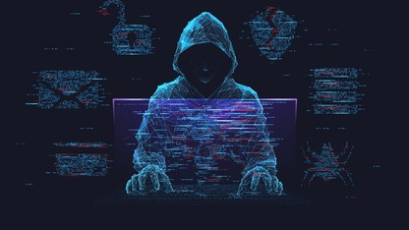
THANK YOU
Stay Safe Online
Khadija | CodeAlpha Internship

